Slide 1
Title of your project
A business presentation Outline guide

Slide 2
OBJECTIVE
1) This is an Insurance company data and we are intended to frame a regression model that can give us a regressed prediction of the **Dependent variable/Target variable Y ** such that we can predict which of the customers (out of the total customers) are the most profitable ones to this Insurance firm.
[**Improvise and write as per your own words.]
2) Considering this objective, we are running a **type of regression model** on target/dependent variable Y, to analyse the influence of several independent factors that affect Y.

Slide 3
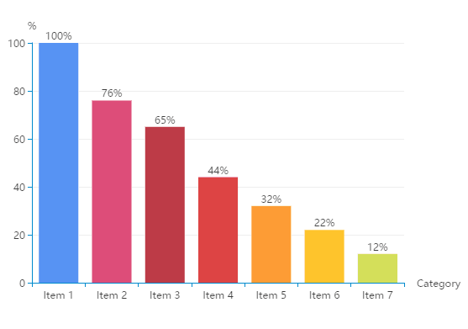
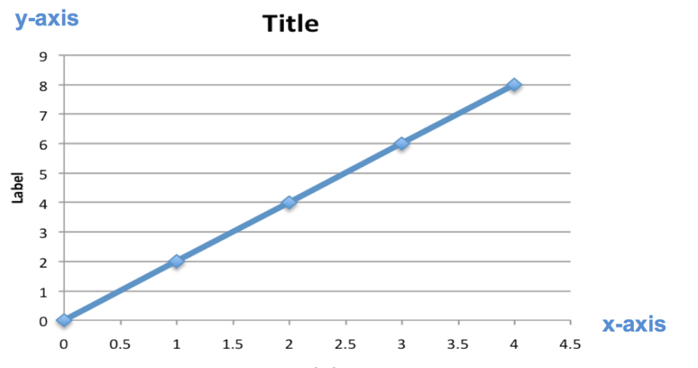
DEPENDENT VARIABLE
***Describe your dependent variable/target variable. Its meaning and purpose or likewise.
*** Graphical representations makes your variable description easier to explain.

Slide 4
Count of variables and observations
*** Mention the number of variables and number of observations.
[***This is the outline guide of your presentation order. Improvise and incorporate your own ways.]

Slide 5
SIGNIFICANT VARIABLES
*** Enlist all the significant variables of your model below.
Variable X1
Variable X2
Variable X3
Variable X4
Variable X5

Slide 6
INSIGNIFICANT VARIABLES
*** Enlist all the insignificant variables of your model below.
Variable X6
Variable X7
Variable X8
Variable X9
Variable X10

Slide 7
Explanation of significant variables
*** Define your significant variables in detail , in connectivity with your dependent variable/target variable.
*** That is, describe your significant variables and their connection with the dependent variable with real life practical analytical intuition.
** Variable X1

Slide 8
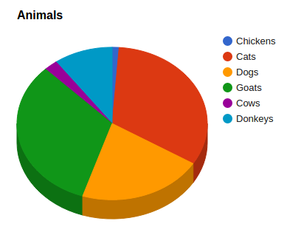
Graphical display of significant variables
*** You may describe your variables graphically in the few following slides for better and simpler understanding of your clients and find it easier to explain it yourself.
** Variable X1

Slide 9
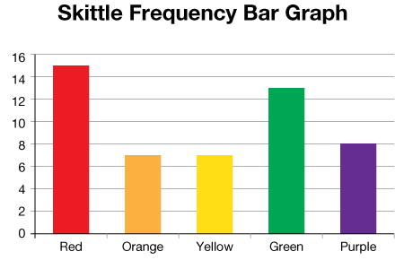
*** Variable X2
*** With the description/ definition of your variable below and its connection with your target variable.

Slide 10
RESULTS OBTAINED
***A brief explanation of the results obtained. But make sure not to express too much of your technical insights because mostly your clients are unaware of the technical and coding/programming knowledge so your explanation should be in layman terms, as much as possible. You can take 2/3 slides to do this.
*** Key and mandatory mentions for this R-Project:
- Your R-square and adjusted-R-square values.
- Your Bp-test outcome and interpretation of outcome in 1/2 lines.
- Your ad-test outcome and interpretation.
- Your Dwt-test outcome and interpretation.
- Your MAPE value and implication of that.
** For other kind of models, mention the appropriate validation test outcome values and interpretations here. For graphical outcomes, mention the same along with the graph in the slide.

Slide 11
*** You may also add an actual value (of target variable) versus predicted values (of target variable) graphical display to show the difference in your actual versus predicted values graphically if you want to .

Slide 12
Variable relationships:
*** Positive variables: Mention the variables with positive coefficients of your final model here.
Variable X1, Variable X2, Variable X3.
*** Negative Variables: Mention the variables with negative coefficients of your final model here.
Variable X4, Variable X5, Variable X6.

Slide 13
Business RECOMMENDATIONs:
*** Mention your business recommendations which you want to convey to your client in 2/3 slides.
*** On a generalised scale, it is advisable to target customers who qualify for the variables that have a POSITIVE relationship with the target variable, as they have an increasing impact on the target variable of the firm, if it is a maximization problem. For a minimization problem, on a generalised scale, it is advisable to target customers who qualify for the variables that have a NEGATIVE relationship with the target variable as they having a decreasing impact on the target variable.
*** Now improvise and frame and write the presentation in your own style and as per your own convenience, making sure the key highlighted heads in this outline is mostly covered.

Slide 14

THANK YOU.
A business presentation Outline guide

